Slide 1
AI Science Robotics – Nao
International BusIT Week
Project Madness

Slide 2
International BusIT week
During this international week students from different ICT disciplines (Software, Technology, business and media) are going to team up to develop an innovative concept for improving quality of life base on a NAO Standard Platform.
APRIL 18 – 22 (Maybe two weeks)
Only 7 weeks from now!

Slide 3
What is M? it’s Madness
We are a group of Fontys students who are going to promote Fontys Robotics events.
What’s Madness’s Goal?
Research and development of NAO Standard Platform in Robotic Science Field.
Invention in AI algorithm is our ultimate goal.

Slide 4
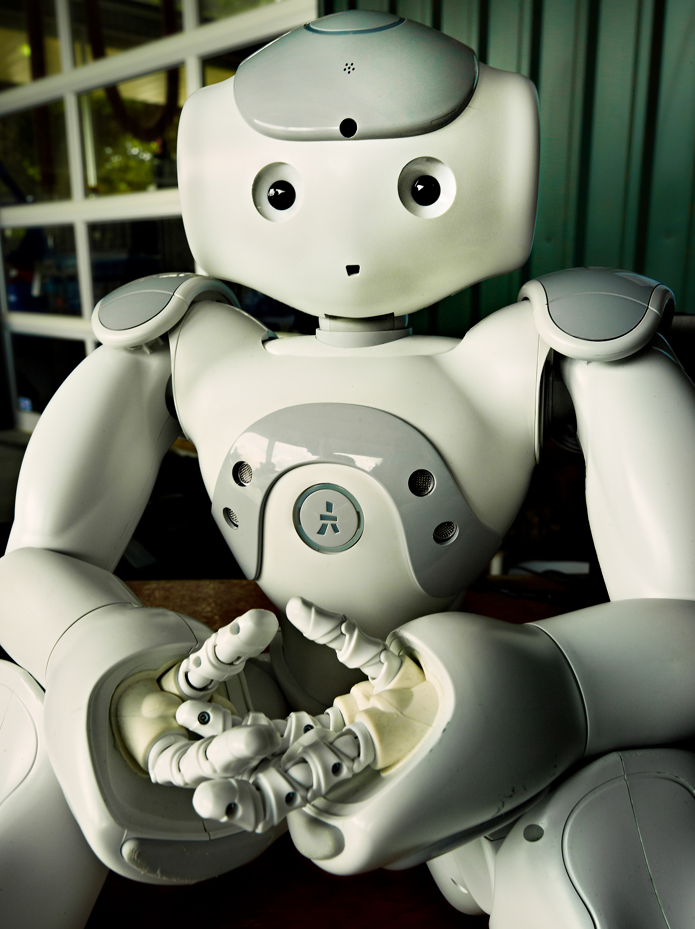
Deliverables
Website for the event
Needed applications for the event
NAO’s Database Design and development
Repository of different scenarios
Advertisements
Teaching materials
Organizing the event
…

Slide 5
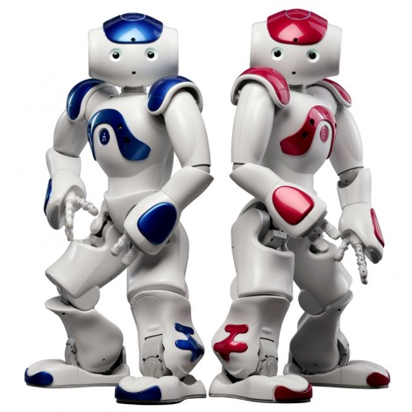




Slide 6
Where to start?
We are dividing our team in 3 different subgroups:
Group Alpha: Working On a robot who is going to perform critical tasks like Registration, giving speech for audience, etc.
Group Beta: Working on a robot who is going to perform showing off operation in order to attract and make ideas in students.
Group Omega: Our Web Developing group who is going to interact directly with both other group in order to get the context of website.
Learning, Analyzing
Designing
Developing
Finalizing
Testing
1st Feb 14th Feb 21th Feb 1st April 8th April 18th The Day

Slide 7
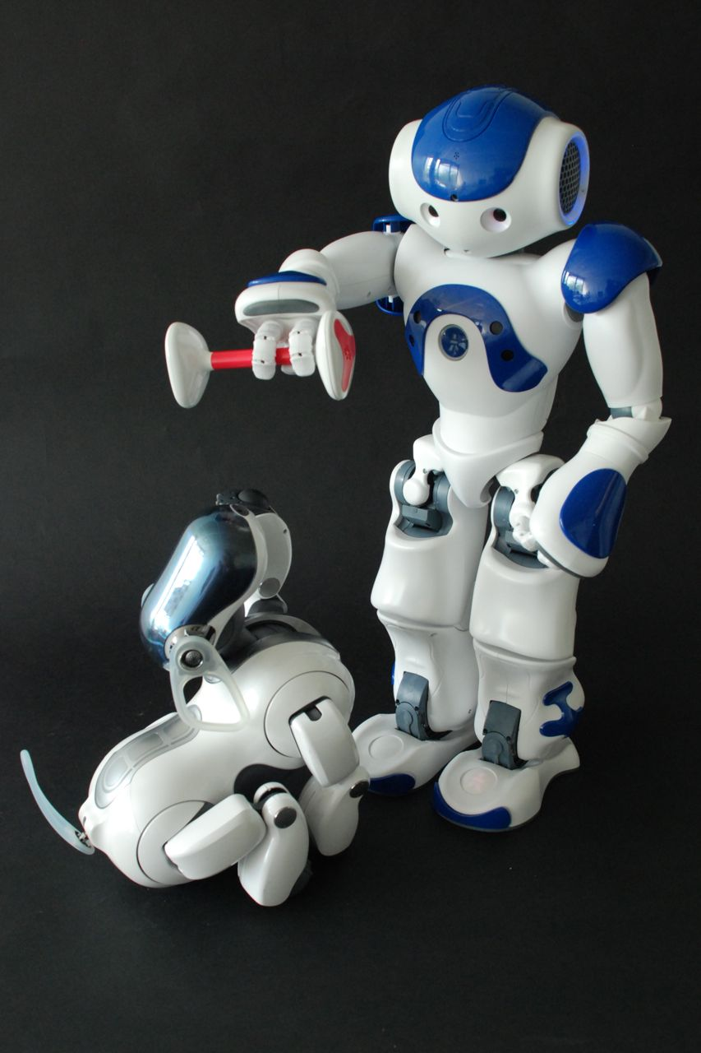
Ideas & Scenarios

Slide 8
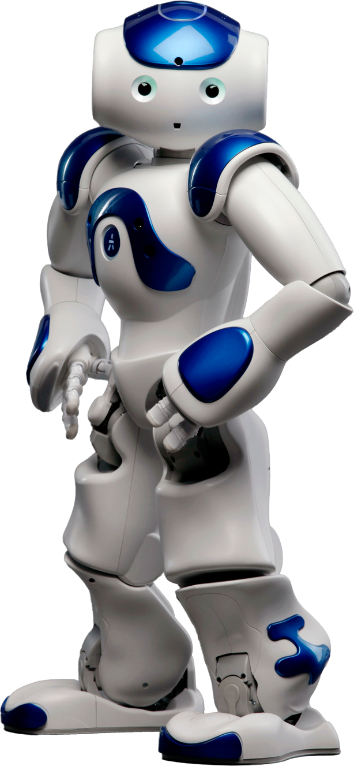
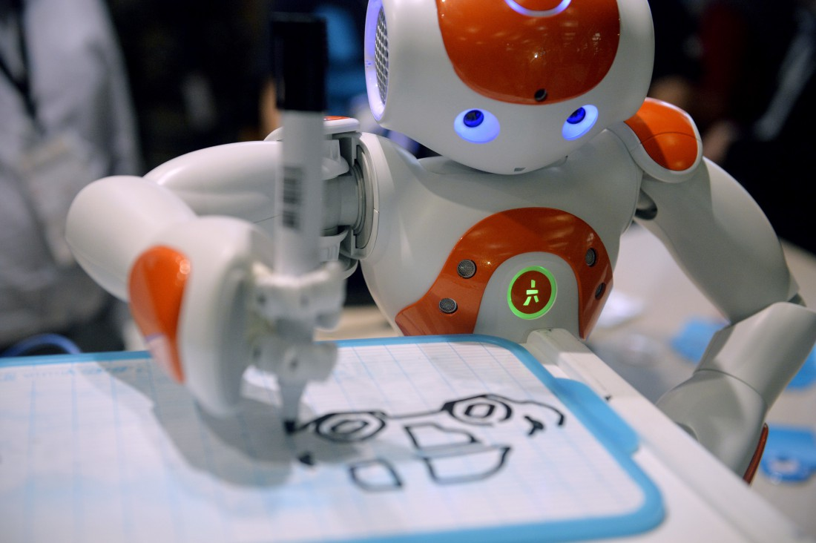

Slide 9
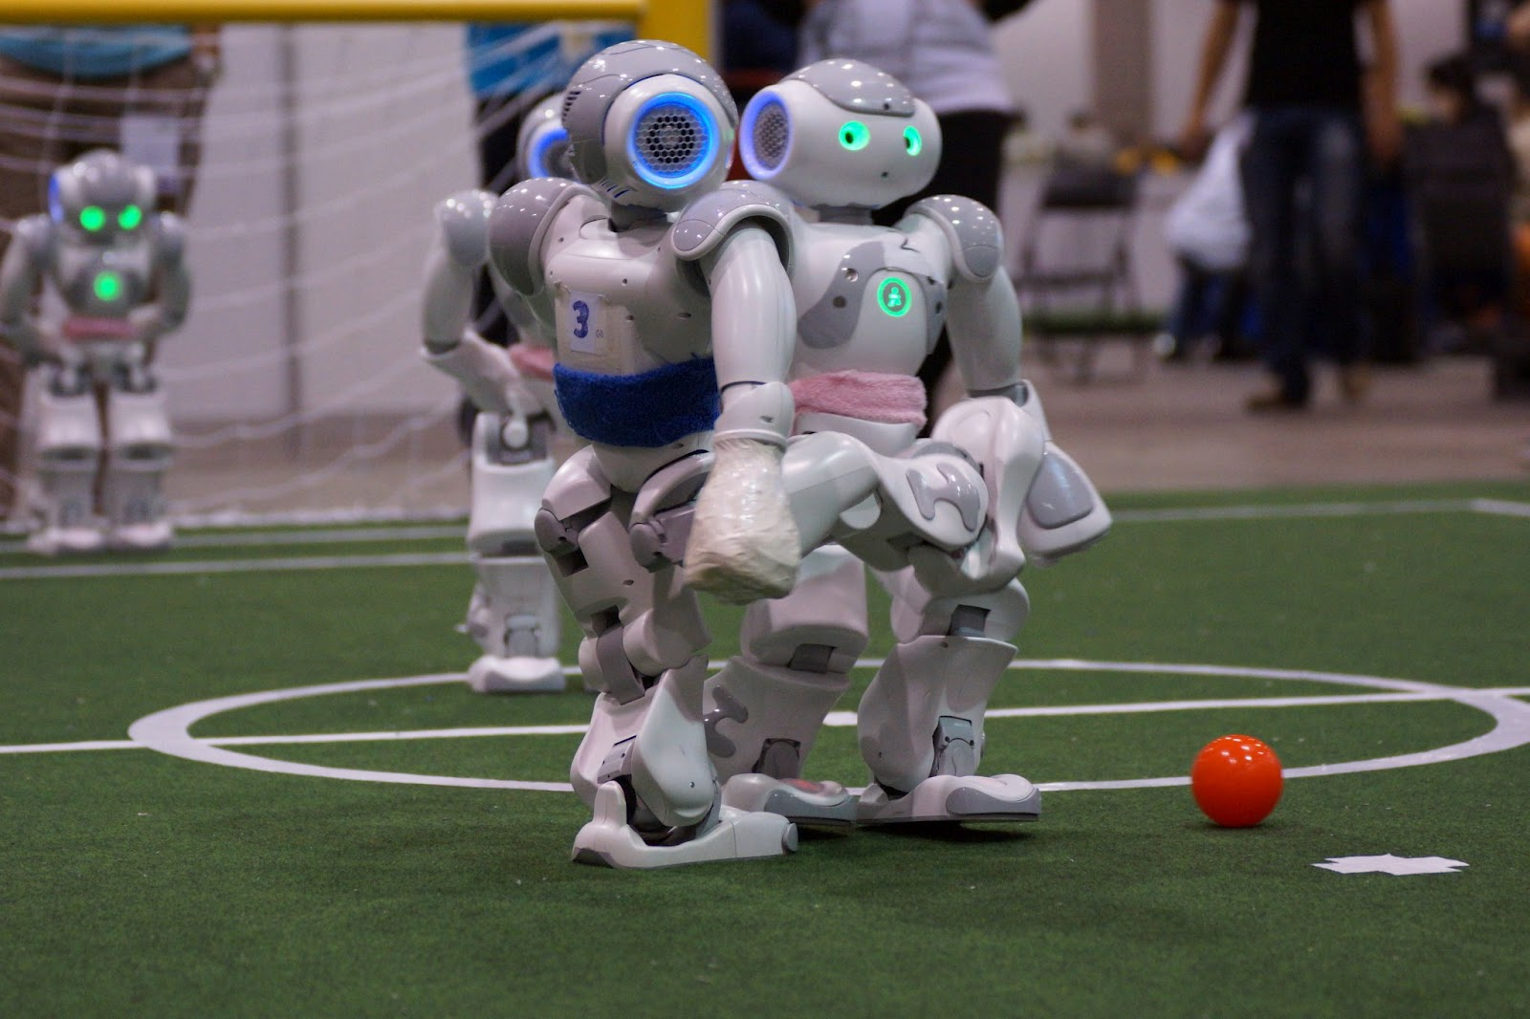
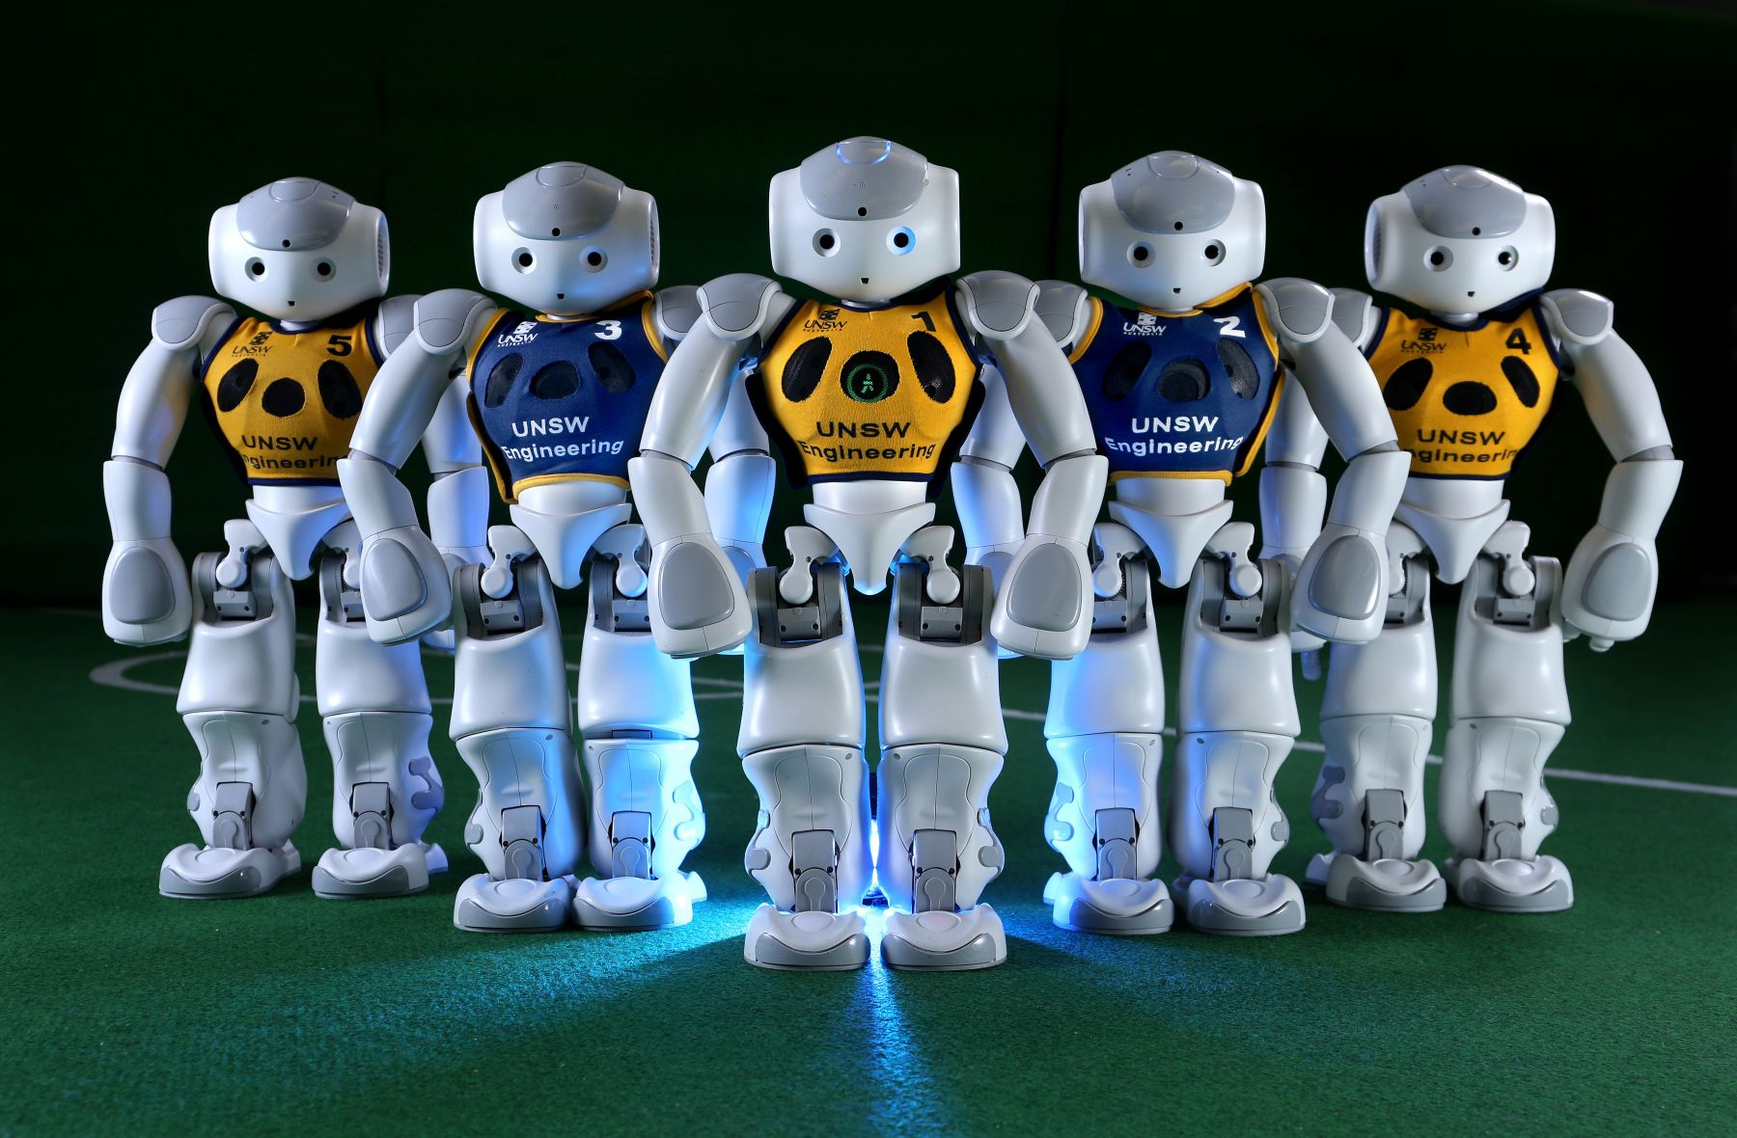

Slide 10
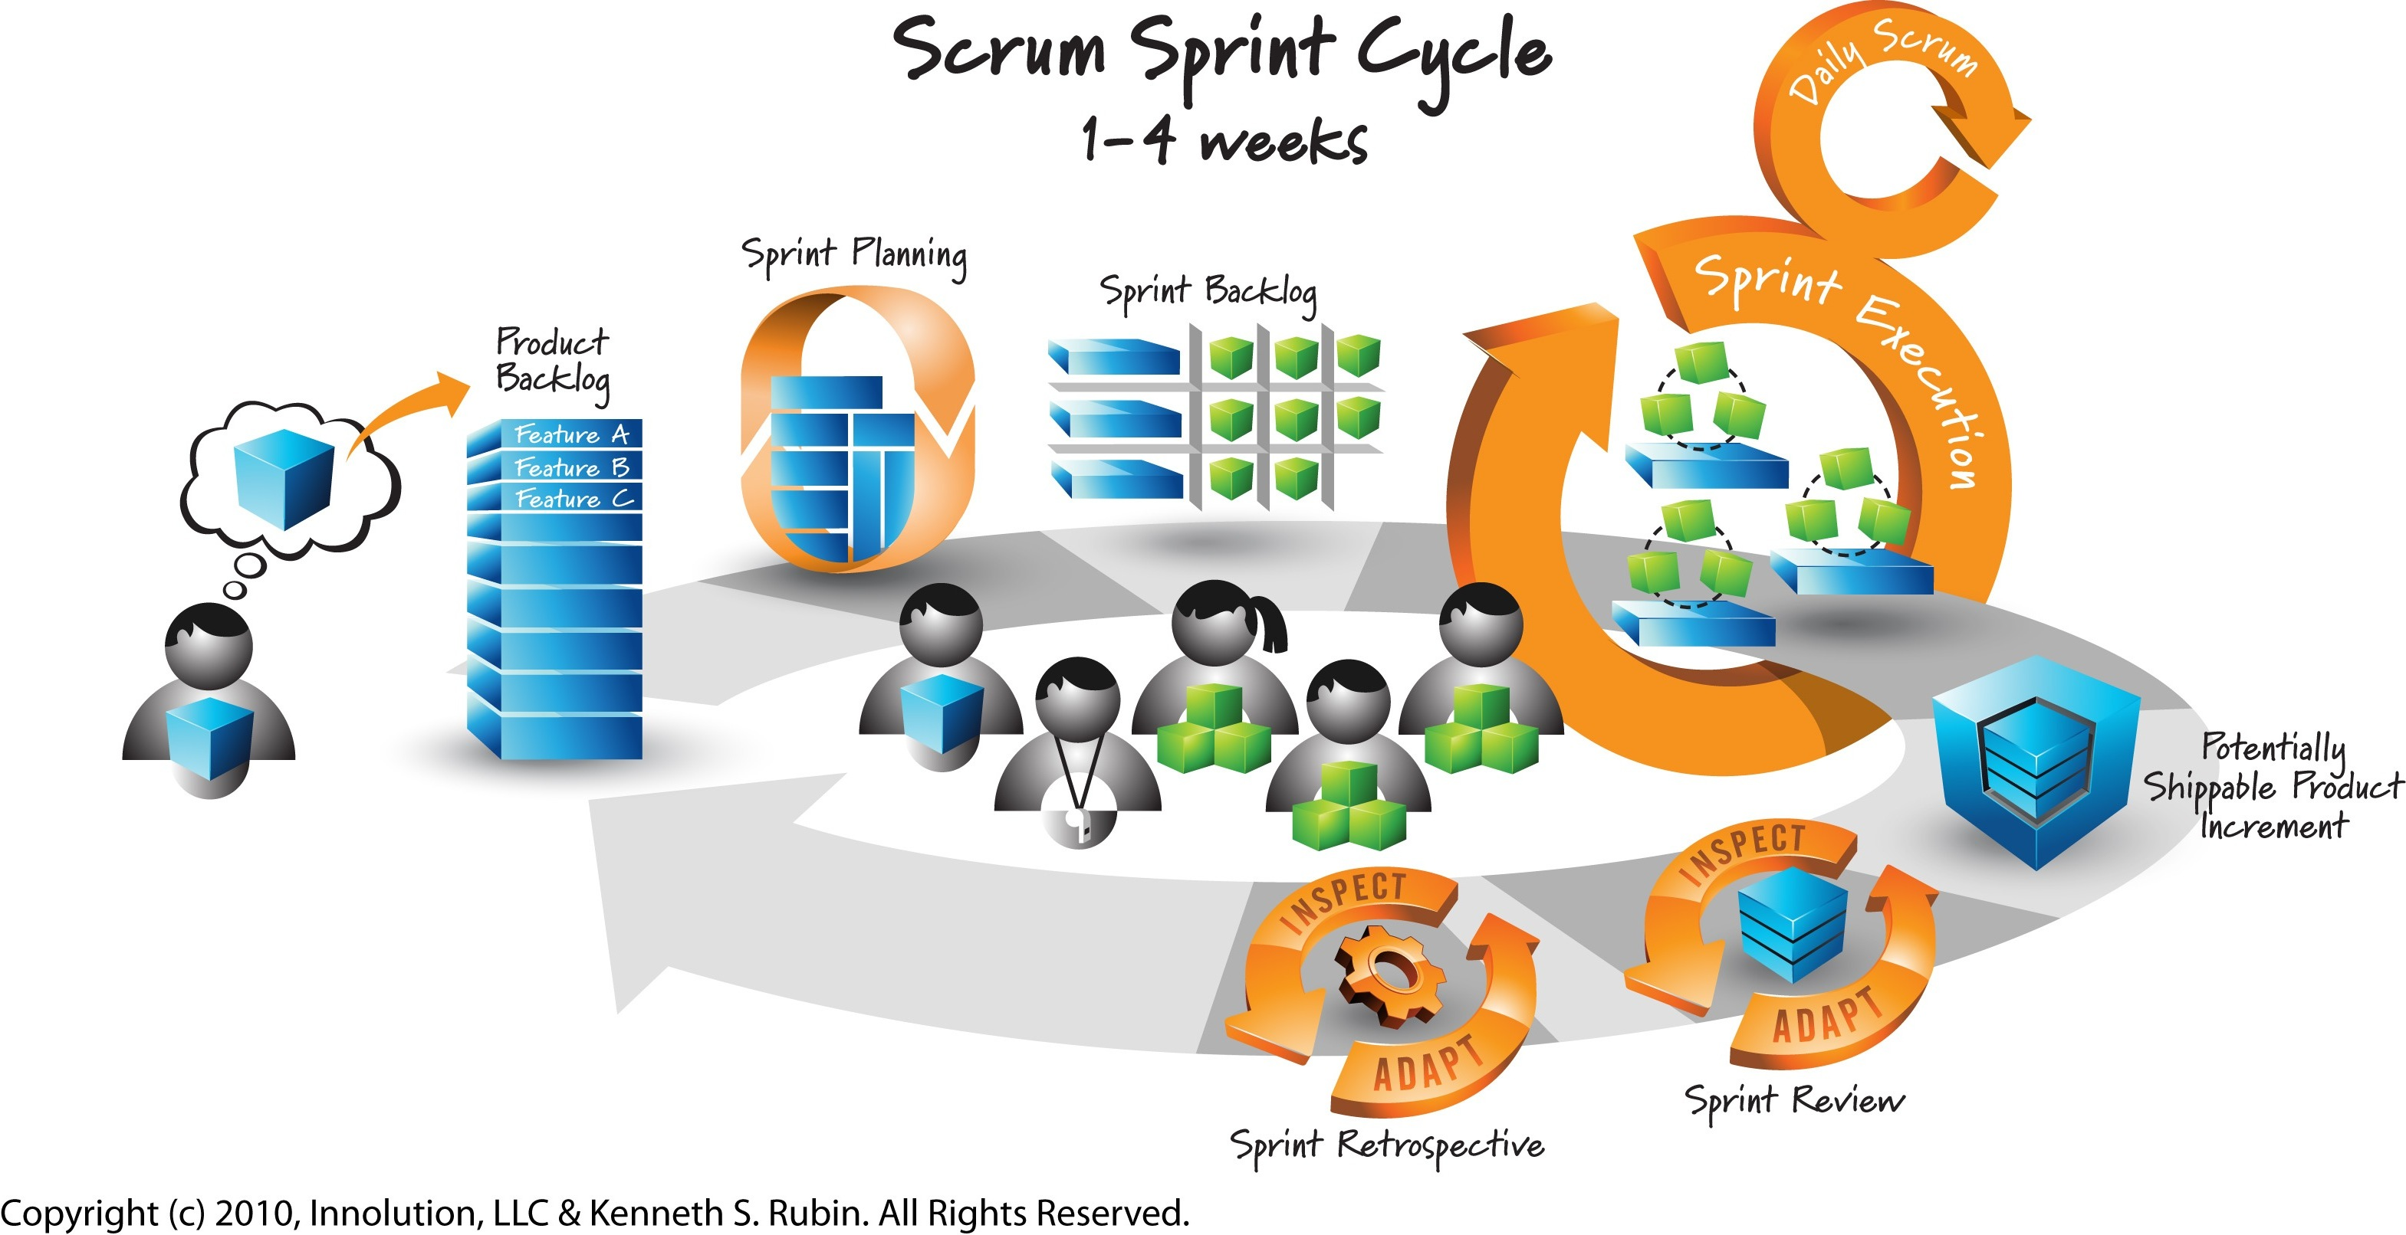
https://www.youtube.com/watch?v=XU0llRltyFM

Slide 11
Resources:
Aldebaran: https://community.aldebaran.com
face recognition: https://www.youtube.com/watch?v=QXmgF_L9wXE#t=434.800793
Tutorial #1: https://www.youtube.com/watch?v=6tTSBT0U1i0
Choregraphe: https://www.youtube.com/watch?v=2byYfgypse8

Slide 12
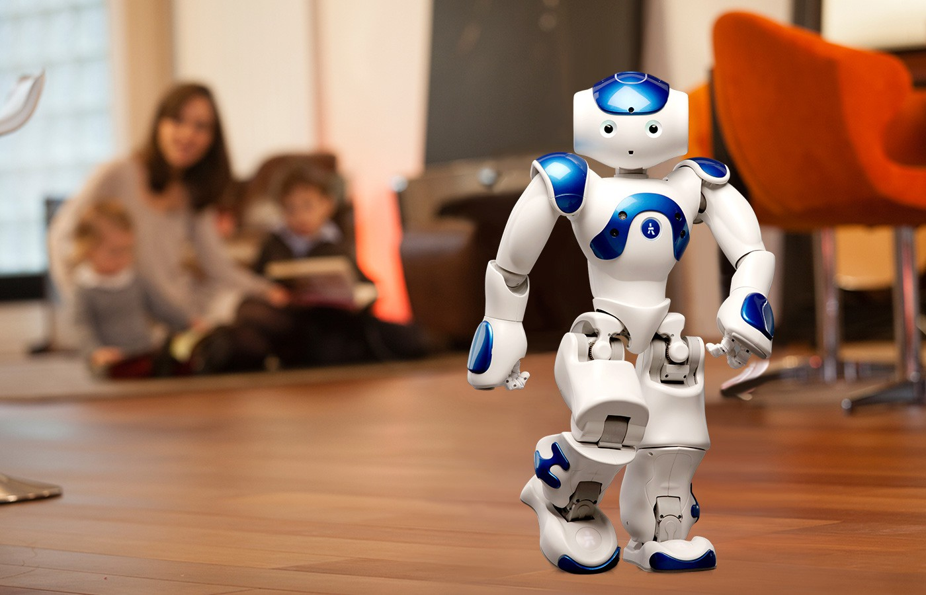
Thank you for being here.

